Slide 1

Haegang Yang
ENGL – 2210 - 016

Slide 2

INTRO
Parasite is the movie about the problem of the hierarchial system based on the economics. Junho Bong, who is the director of the movie is well known as to make a movie with great details. Junho Bong considered ‘crossing the line’ as the most important part in the movie, which means ‘rude’, or doing something by someone who is not supposed to do. Today, I want to talk about some scenes how he represented his idea in the movie.

Slide 3

1. MEANING OF THE LINE

Slide 4
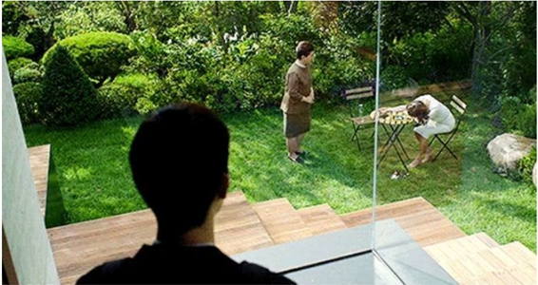
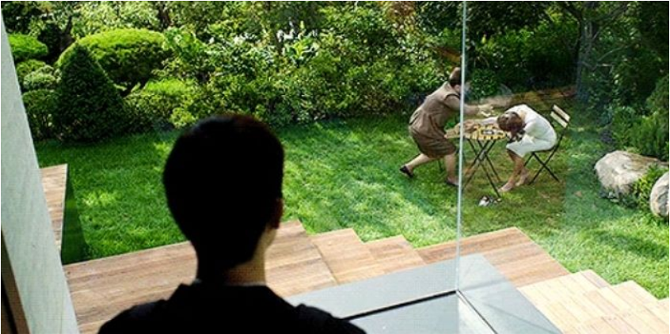
Crossing the line 1
In this scene, there is a vertical line on the window. This is not a line made by graphic. It is just a edge of a glass cage. The director said he intentionally made this composition. Based on the line in the picture, there are a servant woman, and a man from poor family on the left while a woman who owns the house and hires the servant is on the right. Junho Bong wanted to show there is an invisible line between people based on the economical hierarchy. But the servant woman clapped right in front of her employer’s face to wake her up, which is considered as inappropriate habit to the boss. At the same time, we can check her arms just cross the line. It implies how rude she was.

Slide 5

Crossing the line 2
It seems like a peaceful scene. However, the man who lays on the grass is not the one who lives in the house. He just lies on there secretely while the owners were on their vacation and empty the house. As we can see, his leg also crosses the line. The line is visible. But there is another line to him which is invisible.
His actual house is underground, which means he is a poor and in the needy life. The house in the scene is on the mountain, which means the family lives in the house is rich. I think the reason he lies on the ground and face the sky is to show the desire of him to be rich turning against underground which is his poor life. In other word, he is an invisible line himself of his desire in this scene.

Slide 6
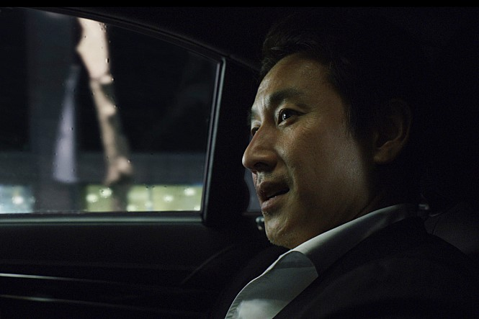
Crossing the line 3
This is the rich man who owns the house on the mountain. Actually, there is another man in this scene, driving the car for the owner. He also lives underground. As we all know, the driver must sit at the front while the owner sit at the back. There is a line between the back and the front seat. This is a usual situation we can experience in real life. However, there is another invisible line in the dialogue.
The owner said, “The smell crosses the line.” The smell indicates the smell of the driver and the man who lied on the grass. It was from the underground house. Based on my experience in Korea it is a smell of fungus. The smell crosses the line more as the poor family penetrates into the rich house more like a parasite. Whether there is smell or not is anther invisble line.

Slide 7
2. SIMILARITY

Slide 8

SIMILARITY 1
Exit west does not have any similar part with the movie Parasite based on the story at all. However, the movie reminds me this book with several reasons. First of all, the way of story development was similar. For example, as I mentioned in my discussion, the Australian woman story is not important based on the story. However, it bluntly shows what the writer wanted to let us know, which was not to imagine the story before we read. Junho Bong, the director of Parsasite used some awkward compositions to highlight ‘the line’. Sometimes I wondered ‘Why the camera suddenly stopped here with this composition?’ The camera moving always makes recognize myself there is something that the director wanted to say in each scenes.

Slide 9
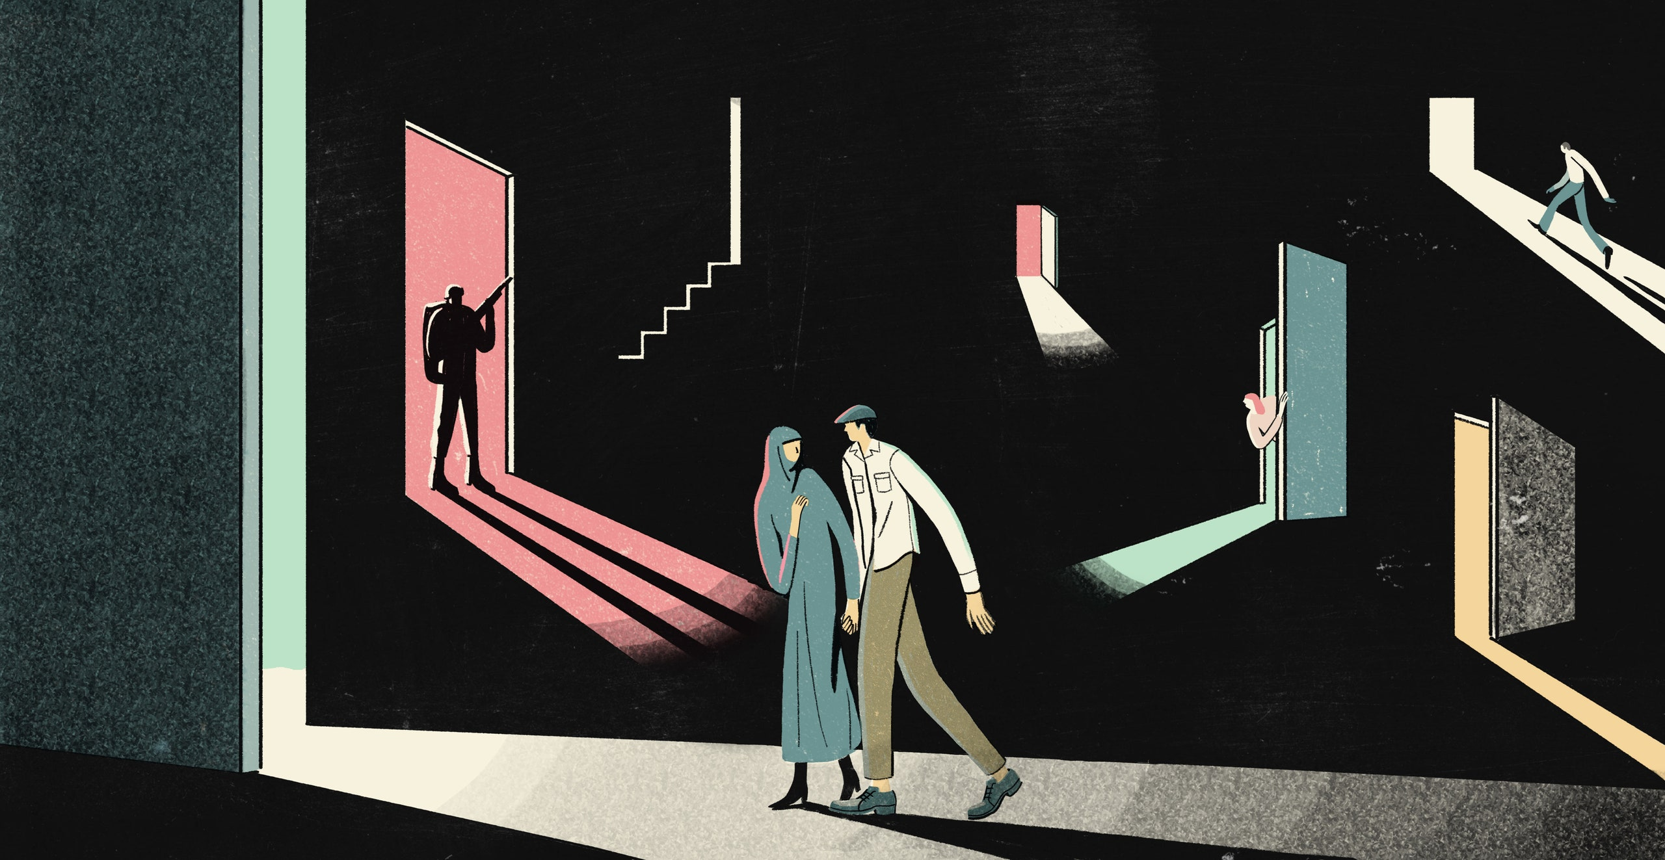
SIMILARITY 2
Next, the portal in the novel and the line have a similar role. In Exit West, the portal makes the characters to go another country and let them in the different situation. For example, they moved to London and under the rejection of the native people there. But when they moved one more, they finally reached the place they can live humanely. In terms of those examples, I think the portal gave them another opportunity of life, also, is a desire of stable and better life. In the movie, all of the characters are separated by the symbolical line. The poor family always wants to cross the line to take the rich family life. In another word, the line is an eager to them for a better life. The portal and the line are different that the line is a target to penetrate and steal, while the portal was a positive hope. However, they are basically the same meaning to those characters in terms of what it was a goal to them.

Slide 10
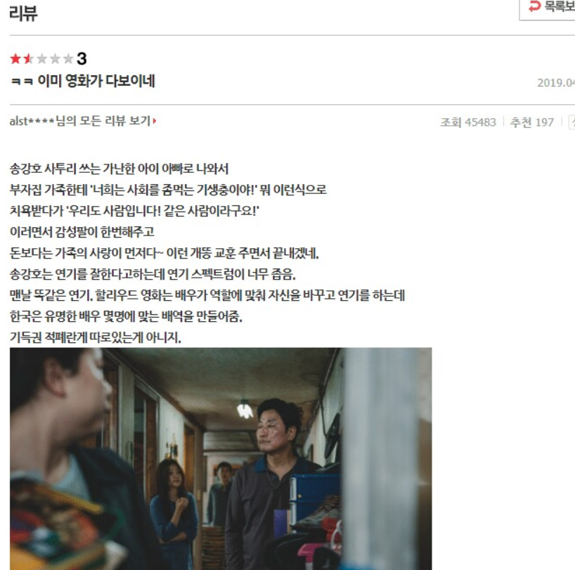
SIMILARITY 3
Finally, those two literature breaks down the cliché. The image is a reply of a Korean who assumed the story of the movie parasite before its release. He said “The rich guys must say to the poor family like ‘You are the parasite of the society’ and the poor family will yell out ‘We are the same human as you’ and it will finish with the moral that ‘love of the family is important than money’. Everything will be same as other movies.” Actually, most of the Koreans imagined like that. But there is literally nothing same from the movie. The villains were the poor family and the rich guys were the victims, which was not a cliché at all. It happens in Exit West too. Even though the characters were Muslim, there was no restriction of having sex or a love marriage. The writer made no cliché with no suggesting of the name of the country where they are from. I consider a movie or a book which do not have any cliché as a good literature. May be this is the reason that they are masterpiece.

Slide 11

CONCLUSION
Junho Bong mentioned that what he wanted to say was not ‘Don’t cross the line. The poor people live as poor.’ But it was about everyone’s duty. Also, the Parasite was for pointing the problem of hierarchial and economical problem. He said he hopes that the movie is remembered to people as it is. He might not want an analysis like what I have done on this slide show. His word makes me watch the movie again to remember the movie as it is for him.

Slide 12
THANK YOU

